Slide 1
Genome Informatics Ryan E. Mills, Ph.D. Department of Computational Medicine & Bioinformatics Department of Human Genetics University of Michigan Medical School Ann Arbor, MI, USA

Slide 2
Genetics and Genomics
Genetics is primarily the study of individual genes, mutations within those genes, and their inheritance patterns in order to understand specific traits.
Genomics expands upon classical genetics and considers aspects of the entire genome, typically using computer aided approaches.

Slide 3
What is a Genome?
The total genetic material of an organism by which individual traits are encoded, controlled, and ultimately passed on to future generations

Slide 4
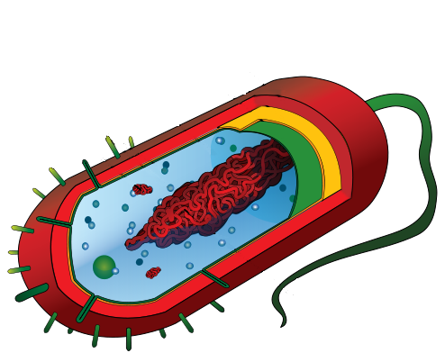
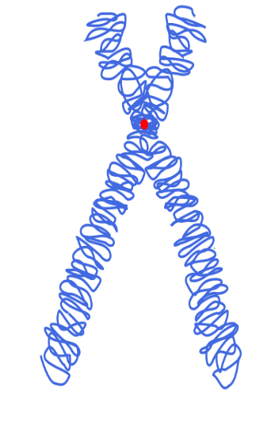
Genomes come in many shapes
Primarily DNA, but can be RNA in the case of some viruses
Some genomes are circular, others linear
Can be organized into discrete units (chromosomes) or freestanding molecules (plasmids)
prokaryote
bacteriophage
eukaryote
Prokaryote by Mariana Ruiz Villarreal| Bacteriophage image by Splette / CC BY-SA | Eukaryote image by Magnus Manske/ CC BY-SA

Slide 5
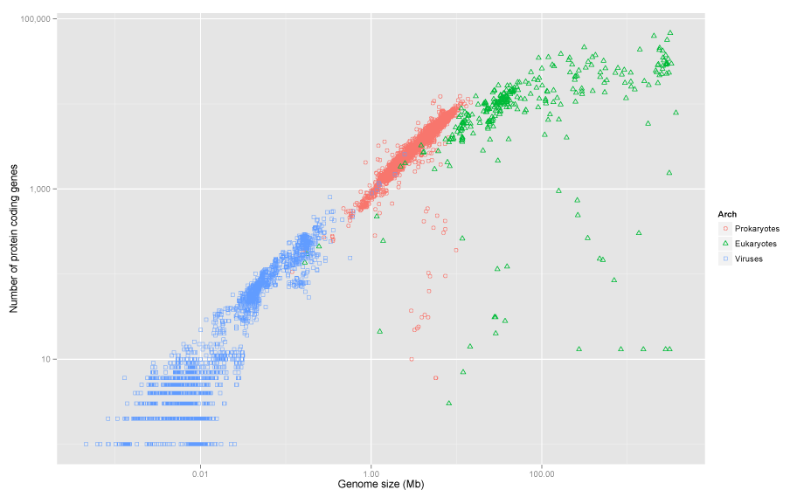
Genomes come in many sizes
Modified from image by Estevezj / CC BY-SA

Slide 6
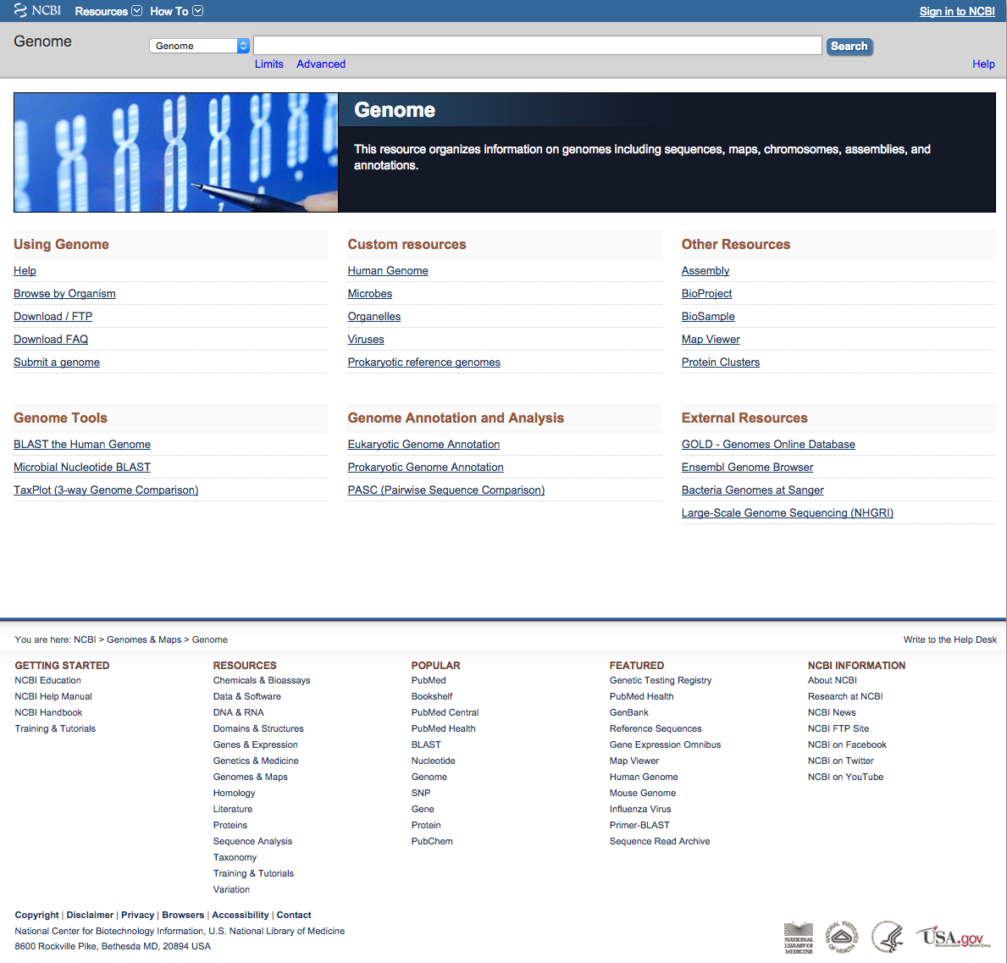
Genome Databases
NCBI Genome:
http://www.ncbi.nlm.nih.gov/genome

Slide 7
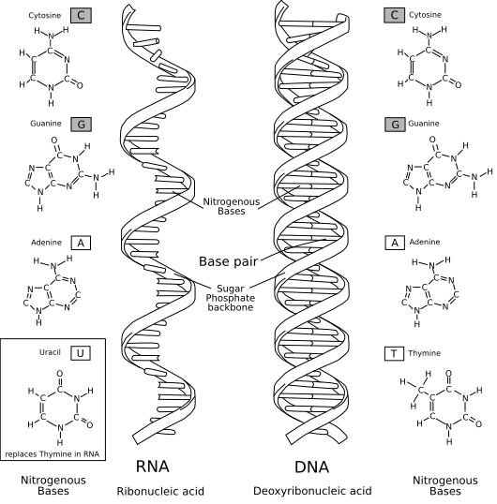
Characteristics of Genomes
All genomes are made up of nucleic acids
DNA and RNA: Adenine (A), Cytosine (C), Guanine (G)
DNA Only: Thymine (T)
RNA Only: Uracil (U)
Typically (but not always), DNA genomes are double stranded (double helix) while RNA genomes are single stranded
Genomes are described as long sequences of nucleic acids, for example: GGACTTCAGGCAACTGCAACTACCTTAGGA
Darryl Leja, Courtesy: National Human Genome Research Institute.

Slide 8
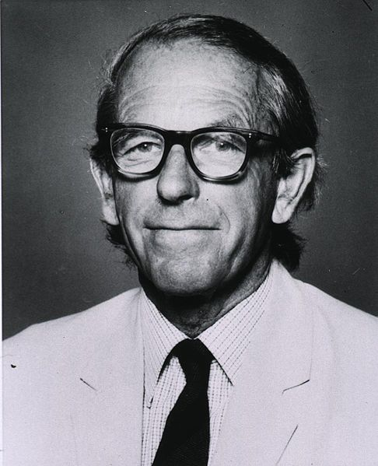
Early Genome Sequencing
Chain-termination “Sanger” sequencing was developed in 1977 by Frederick Sanger, colloquially referred to as the “Father of Genomics”
Sequence reads were typically 750-1000 base pairs in length with an error rate of ~1 / 10000 bases
http://en.wikipedia.org/wiki/Frederick_Sanger

Slide 9
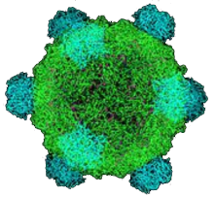
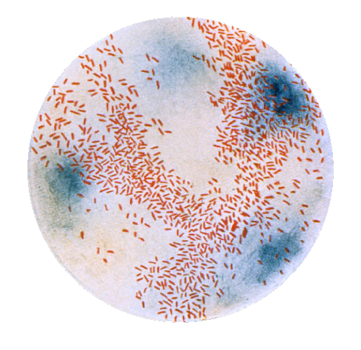
The First Sequenced Genomes
Bacteriophage φ-X174
Completed in 1977
5,386 base pairs, ssDNA
11 genes
Haemophilus influenzae
Completed in 1995
1,830,140 base pairs, dsDNA
1740 genes
http://en.wikipedia.org/wiki/Phi_X_174
http://phil.cdc.gov/

Slide 10
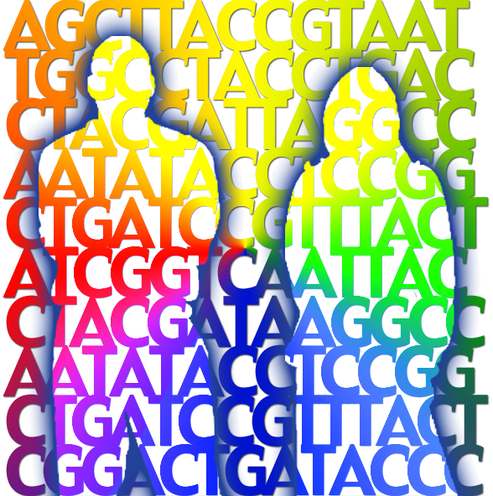
The Human Genome Project
The Human Genome Project (HGP) was an international, public consortium that began in 1990
Initiated by James Watson
Primarily led by Francis Collins
Eventual Cost: $2.7 Billion
Celera Genomics was a private corporation that started in 1998
Headed by Craig Venter
Eventual Cost: $300 Million
Both initiatives released initial drafts of the human genome in 2001
~3.2 Billion base pairs, dsDNA
22 autosomes, 2 sex chromosomes
~20,000 genes
Jane Ades, Courtesy: National Human Genome Research Institute.

Slide 11
What can we do with a Genome?
We can compare genomes, both within and between species, to identify regions of variation and of conservation
We can model genomes, to find interesting patterns reflecting functional characteristics
We can edit genomes, to add, remove, or modify genes and other regions for adjusting individual traits

Slide 12
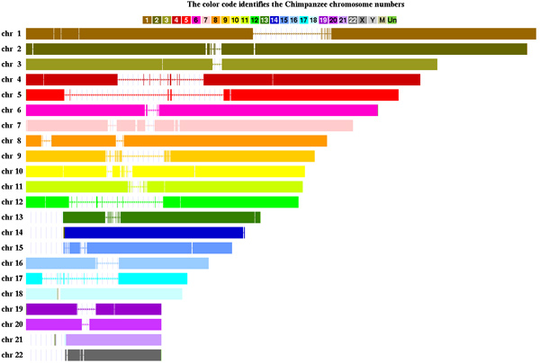
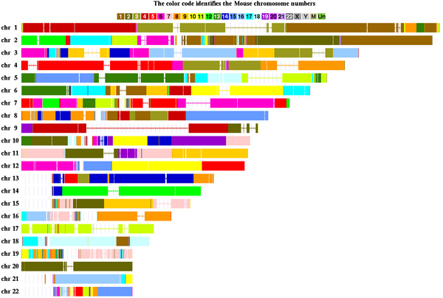
Comparative Genomics
~6-7 million years
~60-70 million years
http://cbse.soe.ucsc.edu/research/comp_genomics/human_chimp_mouse

Slide 13
Conservation Suggests Function
Functional regions of the genome tend to mutate slower than nonfunctional regions due to selective pressures
Comparing genomes can therefore indicate segments of high similarity that have remained conserved across species as candidate genes or regulatory regions
figure generated from: http://genome.ucsc.edu/

Slide 14
Conservation Indicates Loss
Comparing genomes allows us to also see what we have lost over evolutionary time
A model example of this is the loss of “penile spines” in the human lineage due to a human-specific deletion of an enhancer for the androgen receptor gene (McLean et al, Nature, 2011)
human specific deletion
conserved in other mammals
figure generated from: http://genome.ucsc.edu/

Slide 15
Gene Modeling and Prediction
Genomic features such as codon usage patterns can be modeled to identify novel genic regions
Genic Regions:
Intergenic Regions:
ATGACGGTCTGACTGACCATTCAT…
ATGCGGTATGCCTGGAAGCCAGCC…
ATGCTATGGCAAGCCATTGGAGAG…
ATGCCGTTGTTATATGAGCAGATA…
TTAGATTAAAGCCAGGACTGAACG…
TAATGAATGGAACCATACAGAACG…
GACTTAGCCCGAATTTATAGATAC…
TAACTGAATCGATTTAGCCAGGAA…
P(AAA) = 0.001
P(AAC) = 0.020
P(AAG) = 0.025
P(AAT) = 0.003
.
.
P(TTT) = 0.022
P(AAA) = 0.020
P(AAC) = 0.001
P(AAG) = 0.003
P(AAT) = 0.040
.
.
P(TTT) = 0.030

Slide 16
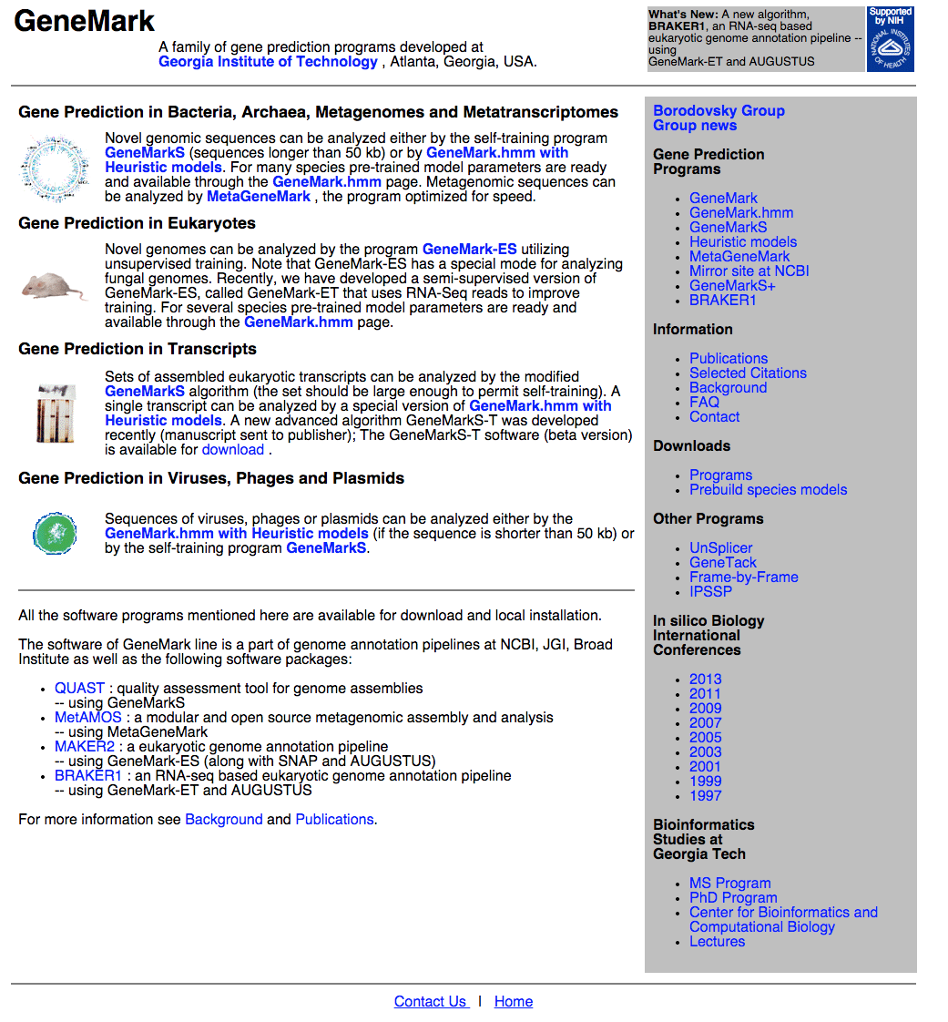
Gene Prediction Software
GeneMark:
http://exon.gatech.edu/GeneMark/

Slide 17
Modern Genome Sequencing
Next Generation Sequencing (NGS) technologies have resulted in a paradigm shift from long reads at low coverage to short reads at high coverage
This provides numerous opportunities for new and expanded genomic applications

Slide 20
Timeline of Sequencing Capacity
Mardis, ER (2011), Nature, 470, pp. 198-203

Slide 21
DNA Sequencing Concepts
Sequencing by Synthesis: Uses a polymerase to incorporate and assess nucleotides to a primer sequence
1 nucleotide at a time
Sequencing by Ligation: Uses a ligase to attach hybridized sequences to a primer sequence
1 or more nucleotides at a time (e.g. dibase)

Slide 22
Modern NGS Sequencing Platforms
Modified from Mardis, ER (2011), Nature, 470, pp. 198-203

Slide 23
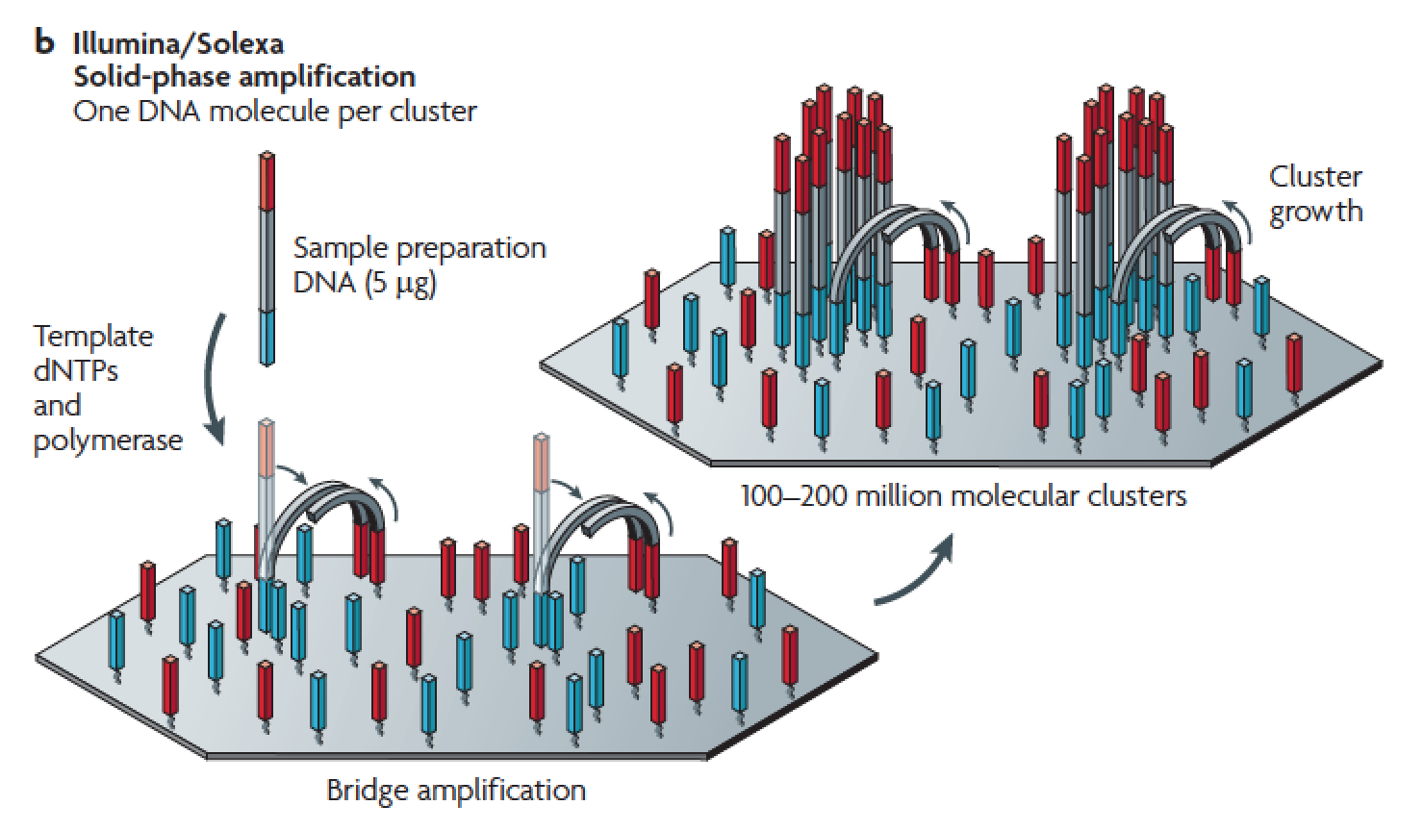
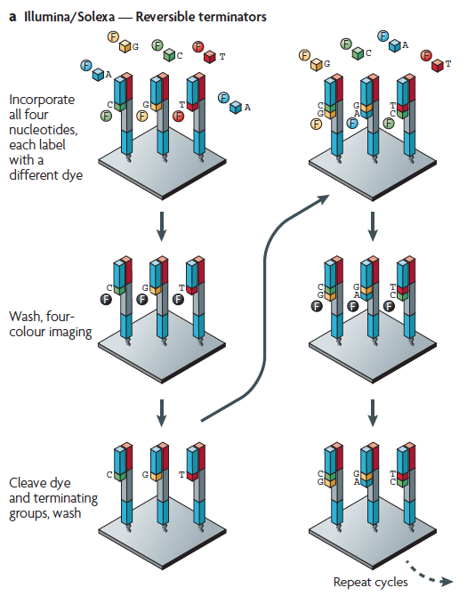
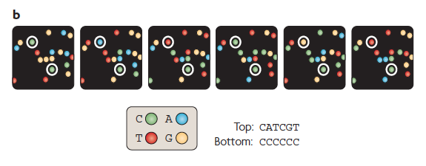
Illumina – Reversible terminators
(other sequencing platforms summarized at end of slide set)
Metzker, ML (2010), Nat. Rev. Genet, 11, pp. 31-46

Slide 24
Illumina Sequencing - Video
https://www.youtube.com/watch?src_vid=womKfikWlxM&v=fCd6B5HRaZ8

Slide 25
NGS Sequencing Terminology
Insert Size
Sequence Coverage
Physical Coverage
length
6X
3X
0
200
400
600
0
1
2
3
4
5
6
7
8
9
10
11
12
0
1
2
3
4
5
6
insert size
base coverage by sequence
base coverage by fragment

Slide 26
Third Generation Sequencing
Currently in transition / development
Hard to define what “3rd” generation means
Typical characteristics:
Long (1,000bp+) sequence reads
Single molecule (no amplification step)
Often associated with nanopore technology
But not necessarily!

Slide 27
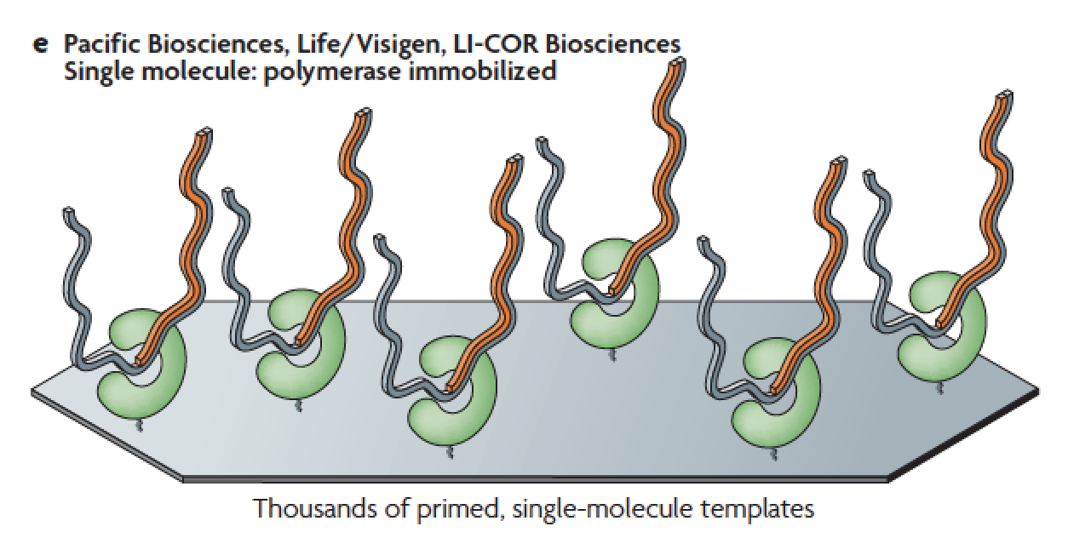
Pacific Biosystems – Real Time Sequencing
zero mode
waveguides
Metzker, ML (2010), Nat. Rev. Genet, 11, pp. 31-46

Slide 28
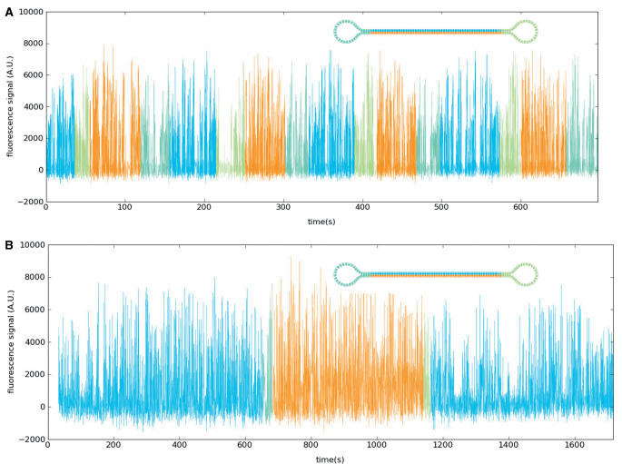
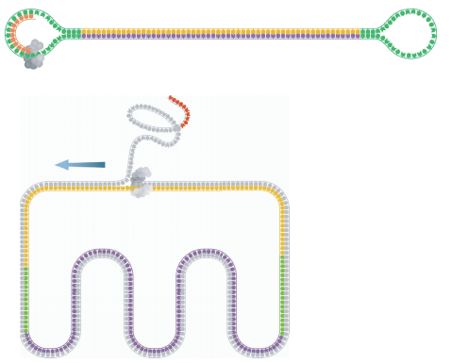
Pacific Biosystems – Circular Consensus
SMRTbell template
Subread Consensus Sequencing
Travers, KJ et al (2010), Nucl. Acids. Res., 38(15) pp. e159

Slide 29
Summary: Generations of DNA Sequencing
Schadt, EE et al (2010), Hum. Mol. Biol., 19(RI2), pp. R227-R240

Slide 30
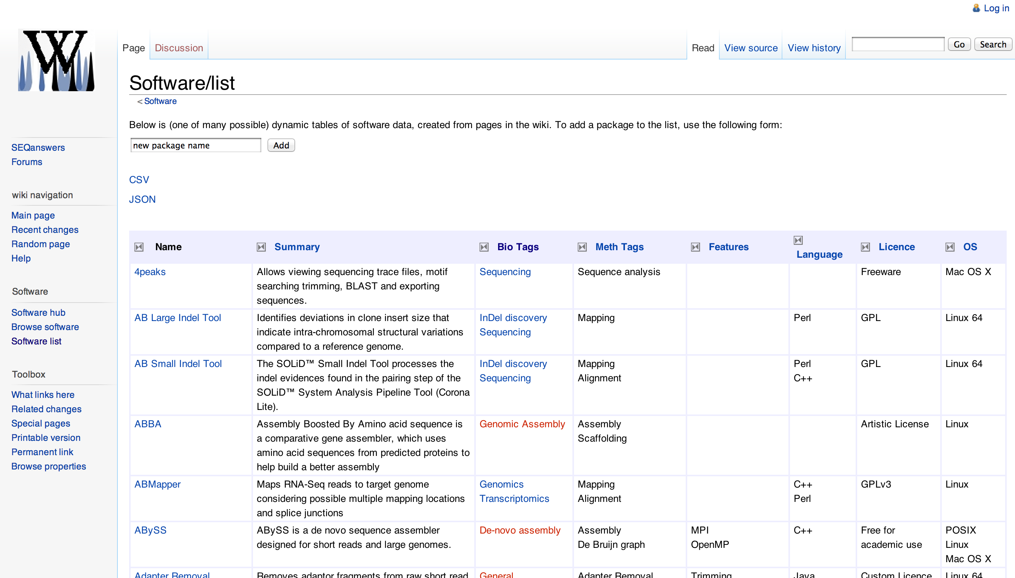
SeqAnswers Wiki
A good repository of analysis software can be found at http://seqanswers.com/wiki/Software/list

Slide 31
Generic Workflow for NGS
There are many different ways to analyze sequences generated from NGS, depending on the specific question you are investigating
For the analysis of genomic sequence data, a typical (if generic) approach is as follows

Slide 32
Quality Control (QC)
Quality checks of raw sequence data are very important
Common problems can include:
Sample mix-up
Sample contamination
Machine interruption
DNA quality
It is crucial that investigators examine their sequences upon first receipt before any downstream analysis is conducted

Slide 33
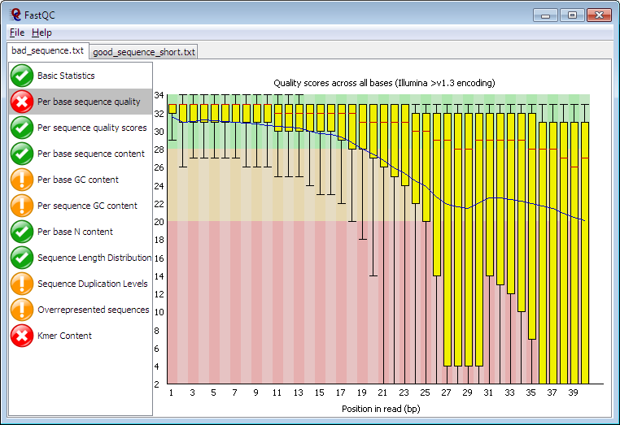
FASTQC
FASTQC is one approach which provides a visual interpretation of the raw sequence reads
http://www.bioinformatics.babraham.ac.uk/projects/fastqc/

Slide 34
Sequence Alignment
Once sequence quality has been assessed, the next step is to align the sequence to a reference genome
There are many distinct tools for doing this; which one you choose is often a reflection of your specific experiment and personal preference
BWA Bowtie SOAP2 Novoalign mr/mrsFast Eland Blat Bfast | BarraCUDA CASHx GSNAP Mosiak Stampy SHRiMP SeqMap SLIDER | RMAP SSAHA etc

Slide 35
SAM Format
Sequence Alignment/Map (SAM) format is the almost-universal sequence alignment format for NGS
binary version is BAM
It consists of a header section (lines start with ‘@’) and an alignment section
The official specification can be found here:
http://samtools.sourceforge.net/SAM1.pdf

Slide 36
Example SAM File
Header section
@HD VN:1.0 SO:coordinate
@SQ SN:1 LN:249250621 AS:NCBI37 UR:file:/data/local/ref/GATK/human_g1k_v37.fasta M5:1b22b98cdeb4a9304cb5d48026a85128
@SQ SN:2 LN:243199373 AS:NCBI37 UR:file:/data/local/ref/GATK/human_g1k_v37.fasta M5:a0d9851da00400dec1098a9255ac712e
@SQ SN:3 LN:198022430 AS:NCBI37 UR:file:/data/local/ref/GATK/human_g1k_v37.fasta M5:fdfd811849cc2fadebc929bb925902e5
@RG ID:UM0098:1 PL:ILLUMINA PU:HWUSI-EAS1707-615LHAAXX-L001 LB:80 DT:2010-05-05T20:00:00-0400 SM:SD37743 CN:UMCORE
@RG ID:UM0098:2 PL:ILLUMINA PU:HWUSI-EAS1707-615LHAAXX-L002 LB:80 DT:2010-05-05T20:00:00-0400 SM:SD37743 CN:UMCORE
@PG ID:bwa VN:0.5.4
Alignment section
1:497:R:-272+13M17D24M 113 1 497 37 37M 15 100338662 0 CGGGTCTGACCTGAGGAGAACTGTGCTCCGCCTTCAG 0;==-==9;>>>>>=>>>>>>>>>>>=>>>>>>>>>> XT:A:U NM:i:0 SM:i:37 AM:i:0 X0:i:1 X1:i:0 XM:i:0 XO:i:0 XG:i:0 MD:Z:37
19:20389:F:275+18M2D19M 99 1 17644 0 37M = 17919 314 TATGACTGCTAATAATACCTACACATGTTAGAACCAT >>>>>>>>>>>>>>>>>>>><<>>><<>>4::>>:<9 RG:Z:UM0098:1 XT:A:R NM:i:0 SM:i:0 AM:i:0 X0:i:4 X1:i:0 XM:i:0 XO:i:0 XG:i:0 MD:Z:37
19:20389:F:275+18M2D19M 147 1 17919 0 18M2D19M = 17644 -314 GTAGTACCAACTGTAAGTCCTTATCTTCATACTTTGT ;44999;499<8<8<<<8<<><<<<><7<;<<<>><< XT:A:R NM:i:2 SM:i:0 AM:i:0 X0:i:4 X1:i:0 XM:i:0 XO:i:1 XG:i:2 MD:Z:18^CA19
9:21597+10M2I25M:R:-209 83 1 21678 0 8M2I27M = 21469 -244 CACCACATCACATATACCAAGCCTGGCTGTGTCTTCT <;9<<5><<<<><<<>><<><>><9>><>>>9>>><> XT:A:R NM:i:2 SM:i:0 AM:i:0 X0:i:5 X1:i:0 XM:i:0 XO:i:1 XG:i:2 MD:Z:35
http://genome.sph.umich.edu/wiki/SAM

Slide 37
SAM Utilities
Samtools is a common toolkit for analyzing and manipulating files in SAM/BAM format
http://samtools.sourceforge.net/
Picard is a another set of utilities that can used to manipulate and modify SAM files
http://picard.sourceforge.net/
These can be used for viewing, parsing, sorting, and filtering SAM files as well as adding new information (e.g. Read Groups)

Slide 38
Post-alignment Optimization
A lot of research has been conducted to improve and optimize sequence alignments
However, genomic sequences are very complex and by their very nature can preclude the ability to accurately determine where a sequence read originated
New tools and approaches have been developed to help address these shortcomings and improve our overall ability to interpret the alignments

Slide 39
Genome Analysis Toolkit (GATK)
Developed in part to aid in the analysis of 1000 Genomes Project data
Includes many tools for manipulating, filtering, and utilizing next generation sequence data
http://www.broadinstitute.org/gatk/

Slide 40
GATK Workflow
DePristo MA et al. (2011) Nat. Genet. 43, pp. 491-498

Slide 41
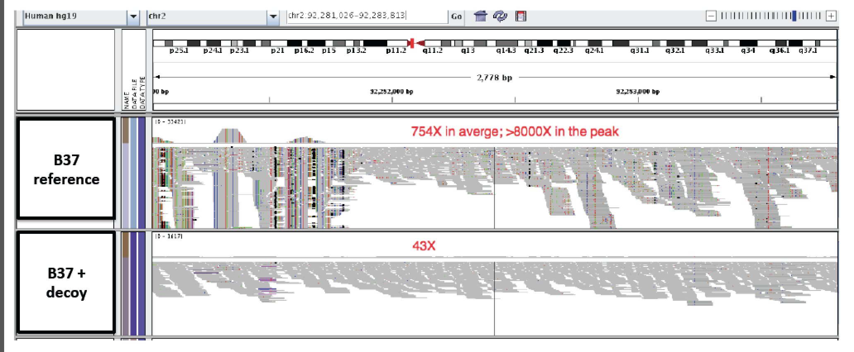
Decoy Mapping
One approach is to allow reads to map to a “decoy” alignment of extra-chromosomal or unassembled sequences
from Heng Li

Slide 42
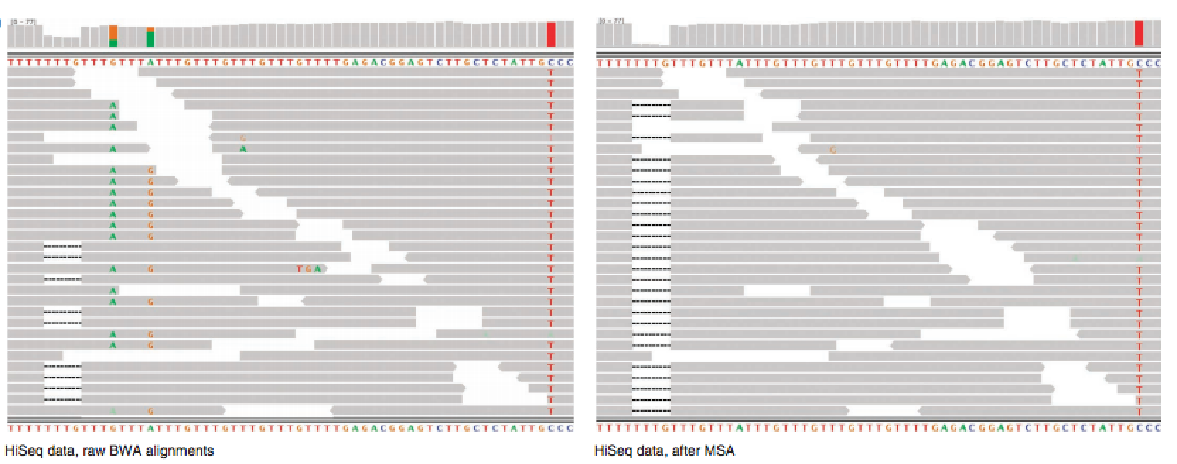
Realignment around INDELs
Insertions and deletions in samples can cause misalignments, resulting in false variant detection
By identifying regions with known INDELs or reads which may have INDEL characteristics and performing multiple sequence alignments, these alignments can be rescued
DePristo MA et al. (2011) Nat. Genet. 43, pp. 491-498

Slide 43
Marking/Removing Duplicate Sequences
Sequence biases can arise from PCR amplification effects during the construction of the library
There can also be optical duplicates which occur when sequences from one cluster are accidentally identified as arising as well from adjacent clusters
Both Picard (MarkDuplicates) and Samtools (rmdup) have utilities for addressing one or both of these issues

Slide 44
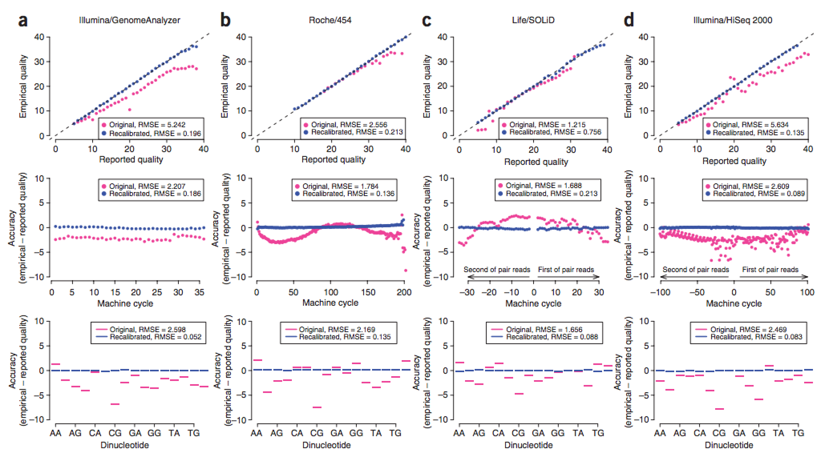
Base Recalibration
Provides empirically accurate base quality scores for each base in every read
Also corrects for error covariates like machine cycle and dinucleotide content
DePristo MA et al. (2011) Nat. Genet. 43, pp. 491-498

Slide 45
Population Scale Analysis
We can now begin to assess genetic differences on a very large scale, both as naturally occurring variation in human and non-human populations as well somatically within tumors

Slide 46
“Variety’s the very spice of life”
-William Cowper, 1785
“Variation is the spice of life”
-Kruglyak & Nickerson, 2001
While the sequencing of the human genome was a great milestone, the DNA from a single person is not representative of the millions of potential differences that can occur between individuals
These unknown genetic variants could be the cause of many phenotypes such as differing morphology, susceptibility to disease, or be completely benign.

Slide 47
Germline Variation
Mutations in the germline are passed along to offspring and are present in the DNA over every cell
In animals, these typically occur in meiosis during gamete differentiation

Slide 48
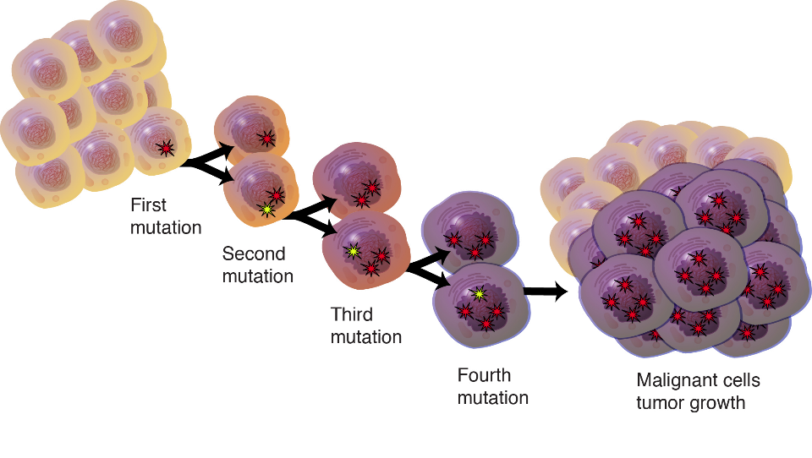
Somatic Variation
Mutations in non-germline cells that are not passed along to offspring
Can occur during mitosis or from the environment itself
Are an integral part in tumor progression and evolution
Darryl Leja, Courtesy: National Human Genome Research Institute.

Slide 49
Mutation vs Polymorphism
A mutation must persist to some extent within a population to be considered polymorphic
>1% frequency is often used
Germline mutations that are not polymorphic are considered rare variants
“From the standpoint of the neutral theory, the rare variant alleles are simple those alleles whose frequencies within a species happen to be in a low-frequency range (0,q), whereas polymorphic alleles are those whose frequencies happen to be in the higher-frequency range (q, 1-q), where I arbitrarily take q = 0.01. Both represent a phase of molecular evolution.”
-Motoo Kimura
Kimura M (1983) Mol. Biol. Evol., 1(1), pp. 84-93

Slide 50
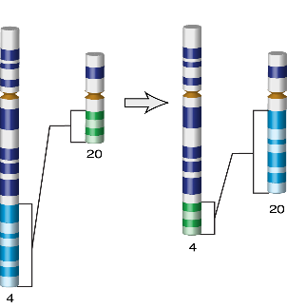
Types of Genomic Variation
Single Nucleotide Polymorphisms (SNPs) – mutations of one nucleotide to another
Insertion/Deletion Polymorphisms (INDELs) – small mutations removing or adding one or more nucleotides at a particular locus
Structural Variation (SVs) – medium to large sized rearrangements of chromosomal DNA
AATCTGAGGCAT
AATCTCAGGCAT
AATCTGAAGGCAT
AATCT--AGGCAT
Darryl Leja, Courtesy: National Human Genome Research Institute.

Slide 51
Variant Subtypes: Repetitive Elements
Mobile Elements / Retrotransposons
Repeat Expansions
ACTT
ALU
ACTTACTTACTTACTTACTTACTT
ALU
ALU
ACTTACTTACTTACTTACTTACTTACTT
(in humans, primarily ALU, LINE, and SVA)

Slide 52
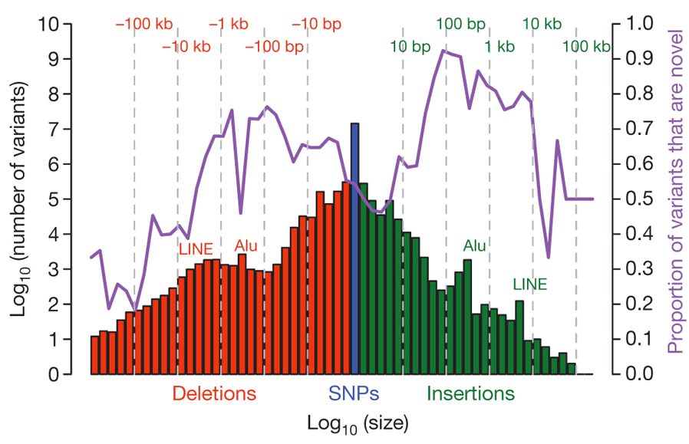
Variant Length Distribution
1000 Genomes Project, Nature, 2010

Slide 53
Differences Between Individuals
The average number of genetic differences in the germline between two random humans can be broken down as follows:
3,600,000 single nucleotide differences
344,000 small insertion and deletions
1,000 larger deletion and duplications
Numbers change depending on ancestry!
1000 Genomes Project, Nature, 2012

Slide 54
Discovering Variation: SNPs and INDELs
Small variants require the use of sequence data to initially be discovered
Most approaches align sequences to a reference genome to identify differing positions
The amount of DNA sequenced is proportional to the number of times a region is covered by a sequence read
More sequence coverage equates to more support for a candidate variant site

Slide 55
Discovering Variation: SNPs and INDELs
SNP
ATCCTGATTCGGTGAACGTTATCGACGATCCGATCGA
sequencing error or genetic variant?
ATCCTGATTCGGTGAACGTTATCGACGATCCGATCGA
CGGTGAACGTTATCGACGATCCGATCGAACTGTCAGC
GGTGAACGTTATCGACGTTCCGATCGAACTGTCAGCG
TGAACGTTATCGACGTTCCGATCGAACTGTCATCGGC
TGAACGTTATCGACGTTCCGATCGAACTGTCAGCGGC
TGAACGTTATCGACGTTCCGATCGAACTGTCAGCGGC
GTTATCGACGATCCGATCGAACTGTCAGCGGCAAGCT
TTATCGACGATCCGATCGAACTGTCAGCGGCAAGCT
ATCCTGATTCGGTGAACGTTATCGACGATCCGATCGAACTGTCAGCGGCAAGCTGATCGATCGATCGATGCTAGTG
reference genome
TTATCGACGATCCGATCGAACTGTCAGCGGCAAGCT
TCGACGATCCGATCGAACTGTCAGCGGCAAGCTGAT
ATCCGATCGAACTGTCAGCGGCAAGCTGATCG CGAT
TCCGAGCGAACTGTCAGCGGCAAGCTGATCG CGATC
TCCGATCGAACTGTCAGCGGCAAGCTGATCGATCGA
GATCGAACTGTCAGCGGCAAGCTGATCG CGATCGA
sequencing error or genetic variant?
AACTGTCAGCGGCAAGCTGATCG CGATCGATGCTA
TGTCAGCGGCAAGCTGATCGATCGATCGATGCTAG
TCAGCGGCAAGCTGATCGATCGATCGATGCTAGTG
INDEL

Slide 56
Genotyping Small Variants
Once discovered, oligonucleotide probes can be generated with each individual allele of a variant of interest
A large number can then be assessed simultaneously on microarrays to detect which combination of alleles is present in a sample

Slide 57
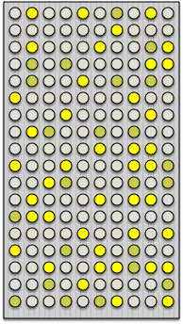
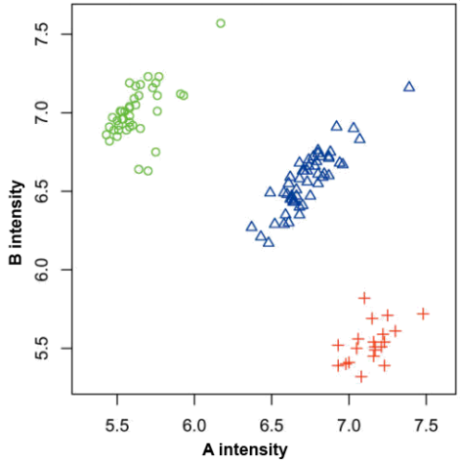
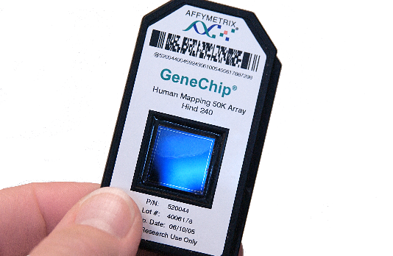
SNP Microarrays
TAACGATGAATCTTAGGCATCGCGC
TAACGATGAATCGTAGGCATCGCGC
genotype: T/T
Shearing
Labeling
GGCTTAAGTACCCTATGGATTACGG
GGCTTAAGTACCTTATGGATTACGG
genotype: C/T
Maggie Bartlett, Courtesy: National Human Genome Research Institute.

Slide 58
Discovering Variation: SVs
Structural variants can be discovered by both sequence and microarray approaches
Microarrays can only detect genomic imbalances, specifically copy number variants (CNVs)
Sequence based approaches can, in principle, identify all types of structural rearrangements

Slide 59
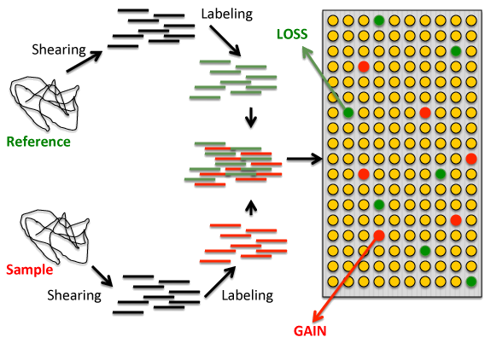
Microarray-based CNV Discovery
Comparative Genomic Hybridization (CGH)

Slide 60
Sequenced-based SV Discovery
Read Pair Mapping
Read Depth Analysis
fragmentation
sequencing
< expected
sample genome
deletion
expected
> expected
reference genome
exact breakpoints
sample genome
deletion
exact breakpoints
fragmentation
sequencing
Split Read Alignment
Sequence Assembly

Slide 61
Variant Databases and Formats
dbSNP – repository for SNP and small INDELs
http://www.ncbi.nlm.nih.gov/SNP/
VCF – variant call format for reporting variation
https://github.com/samtools/hts-specs

Slide 62
VCF Format Example
##fileformat=VCFv4.2
##fileDate=20090805
##source=myImputationProgramV3.1
##reference=file:///seq/references/1000GenomesPilot-NCBI36.fasta
##contig=<ID=20,length=62435964,assembly=B36,md5=f126cdf8a6e0c7f379d618ff66beb2da,species="Homo sapiens",taxonomy=x>
##phasing=partial
##INFO=<ID=NS,Number=1,Type=Integer,Description="Number of Samples With Data”>
##INFO=<ID=DP,Number=1,Type=Integer,Description="Total Depth”>
##INFO=<ID=AF,Number=A,Type=Float,Description="Allele Frequency”>
##INFO=<ID=AA,Number=1,Type=String,Description="Ancestral Allele”>
##INFO=<ID=DB,Number=0,Type=Flag,Description="dbSNP membership, build 129”>
##INFO=<ID=H2,Number=0,Type=Flag,Description="HapMap2 membership”>
##FILTER=<ID=q10,Description="Quality below 10”>
##FILTER=<ID=s50,Description="Less than 50% of samples have data”>
##FORMAT=<ID=GT,Number=1,Type=String,Description="Genotype”>
##FORMAT=<ID=GQ,Number=1,Type=Integer,Description="Genotype Quality”>
##FORMAT=<ID=DP,Number=1,Type=Integer,Description="Read Depth”>
##FORMAT=<ID=HQ,Number=2,Type=Integer,Description="Haplotype Quality”>
#CHROM POS ID REF ALT QUAL FILTER INFO FORMAT NA00001 NA00002 NA00003
20 14370 rs6054257 G A 29 PASS NS=3;DP=14;AF=0.5;DB;H2 GT:GQ:DP:HQ 0|0:48:1:51,51 1|0:48:8:51,51 1/1:43:5:.,.
20 17330 . T A 3 q10 NS=3;DP=11;AF=0.017 GT:GQ:DP:HQ 0|0:49:3:58,50 0|1:3:5:65,3 0/0:41:3
20 1110696 rs6040355 A G,T 67 PASS NS=2;DP=10;AF=0.333,0.667;AA=T;DB GT:GQ:DP:HQ 1|2:21:6:23,27 2|1:2:0:18,2 2/2:35:4
20 1230237 . T . 47 PASS NS=3;DP=13;AA=T GT:GQ:DP:HQ 0|0:54:7:56,60 0|0:48:4:51,51 0/0:61:2
21 1234567 microsat1 GTC G,GTCT 50 PASS NS=3;DP=9;AA=G GT:GQ:DP 0/1:35:4 0/2:17:2 1/1:40:3

Slide 63
Impact of Genetic Variation
There are numerous ways genetic variation can exhibit functional effects
premature stop codons
gene or exon deletion
TAC->TAA
Oct-1
X
frameshift mutation
transcription factor binding disruption
TAC->T-C
ATGCAAAT->ATGCAGAT

Slide 64
Variant Annotation
Variants are annotated based on their potential functional impact
For variants falling inside genes, there are a number of software packages that can be used to quickly determine which may have a functional role (missense/nonsense mutations, splice site disruption, etc)
A few examples are:
ANNOVAR (http://www.openbioinformatics.org/annovar/)
VAAST (http://www.yandell-lab.org/software/vaast.html)
VEP (http://http://grch37.ensembl.org/Homo_sapiens/Tools/VEP)
SeattleSeq (http://snp.gs.washington.edu/SeattleSeqAnnotation134/)
snpEff (http://snpeff.sourceforge.net/)

Slide 65
Variant Annotation Classes
High Impact
exon_deleted
frame_shift
splice_acceptor
splice_donor
start_loss
stop_gain
stop_loss
non_synonymous_start
transcript_codon_change
Medium Impact
non_syn_coding
inframe_codon_gain
inframe_codon_loss
inframe_codon_change
codon_change_del
codon_change_ins
UTR_5_del
UTR_3_del
other_splice_variant
mature_miRNA
regulatory_region
TF_binding_site
regulatory_region_ablation
regulatory_region_amplification
TFBS_ablation
TFBS_amplification
Low Impact
synonymous_stop
synonymous_coding
UTR_5_prime
UTR_3_prime
intron
CDS
upstream
downstream
intergenic
intragenic
gene
transcript
exon
start_gain
synonymous_start
intron_conserved
nc_transcript
NMD_transcript
transcript_codon_change
incomplete_terminal_codon
nc_exon
transcript_ablation
transcript_amplification
feature elongation
feature truncation
GEMINI, http://gemini.readthedocs.org/

Slide 66
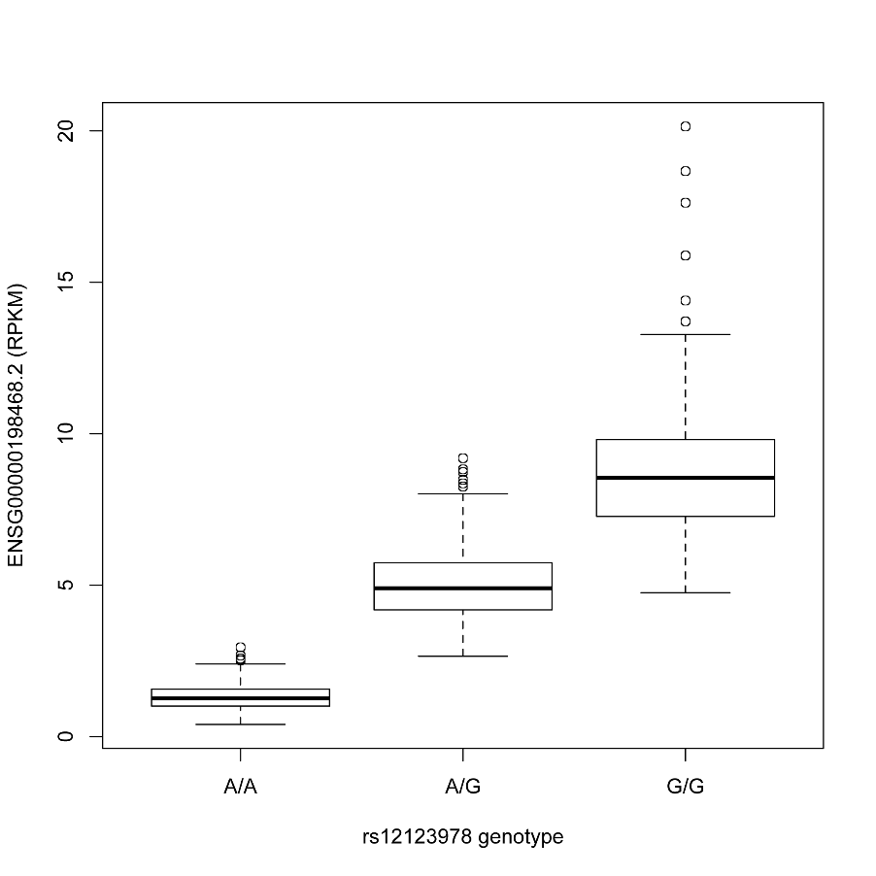
Variation and Gene Expression
Expression quantitative trait loci (eQTLs) are regions of the genome that are associated with expression levels of genes
These regions can be nearby (cis) or far away (trans) from the genes that they affect
Genetic variants in eQTL regions are typically responsible through changes to regulatory elements
Data generated from http://www.geuvadis.org/

Slide 67
Geuvadis Consortium
http://www.geuvadis.org/web/geuvadis

Slide 68
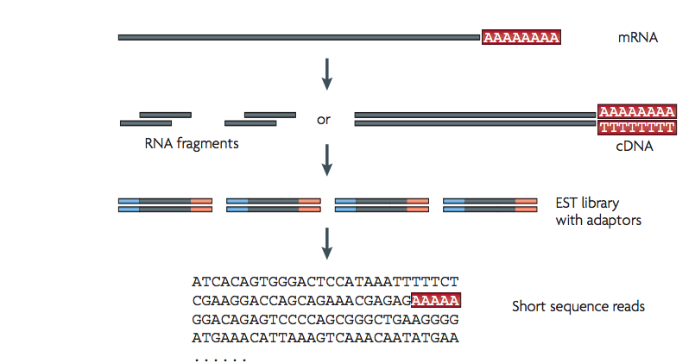
RNA Sequencing
Uses same technologies as DNA sequencing
Primary difference is in library preparation
RNA converted to cDNA through reverse transcription
Wang, Z et al (2009), Nat Rev Genet., 10, pp. 57-63

Slide 69
RNA-Seq Overview
Sample Preparation
Sequencing
Read Alignment
Transcript
compilation
Gene
identification
Differential
expression
RNA-seq reads (2x100bp)
Bowtie/Tophat
Alignment (genome)
Cufflinks
Cufflinks
(cuffmerge)
Cuffdiff
Analysis Pipeline (Tophat)
http://rnaseq.uoregon.edu/

Slide 70
Types of RNA-Seq Libraries
poly(A) capture – utilizes oligo(dT) to prime off of mature mRNA
Won’t amplify non-coding mRNA (e.g. lincRNAs, miRNAs, etc)
Has enrichment biases between 3’ and 5’ ends due to RT drop-offs
Won’t work with fragmented RNA
random hexamer priming – primes at random positions along the transcript
Will work with fragmented or degraded RNA (e.g. FFPE samples)
Removes positional biases of poly(A) capture
Requires some type of rRNA removal (e.g. Ribo-Zero) to address its overabundance

Slide 71
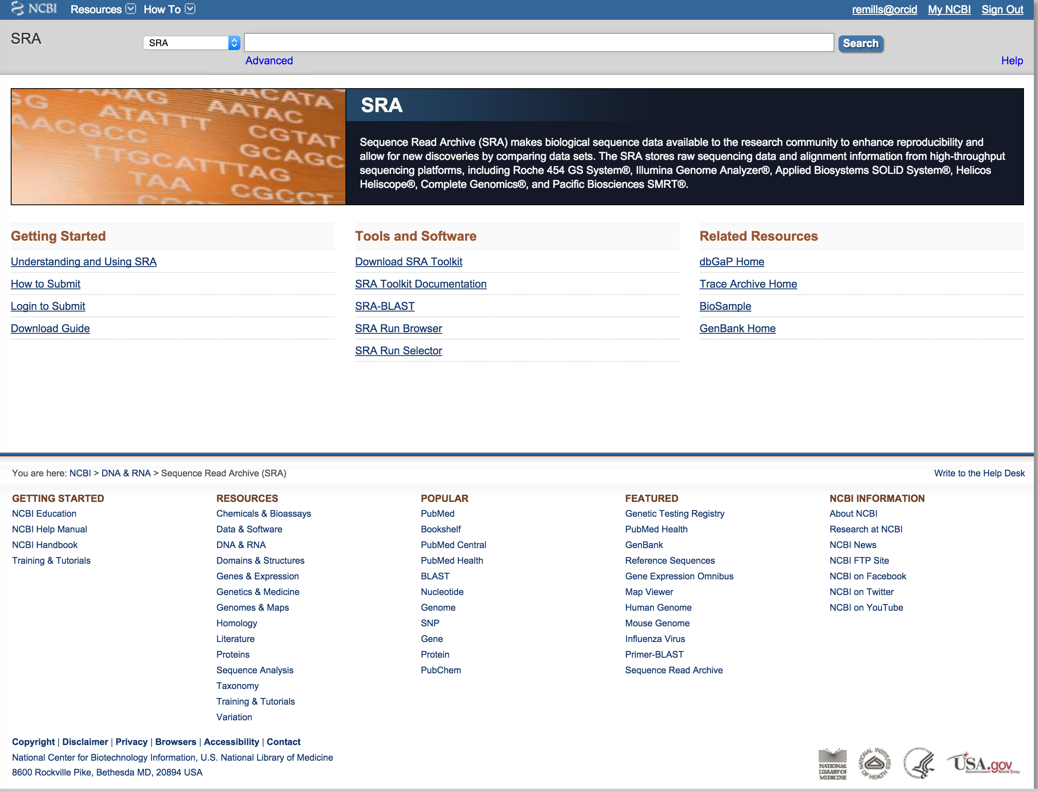
DNA- and RNA-Seq Databases
NCBI Short Read Archive (SRA):
http://www.ncbi.nlm.nih.gov/sra

Slide 72
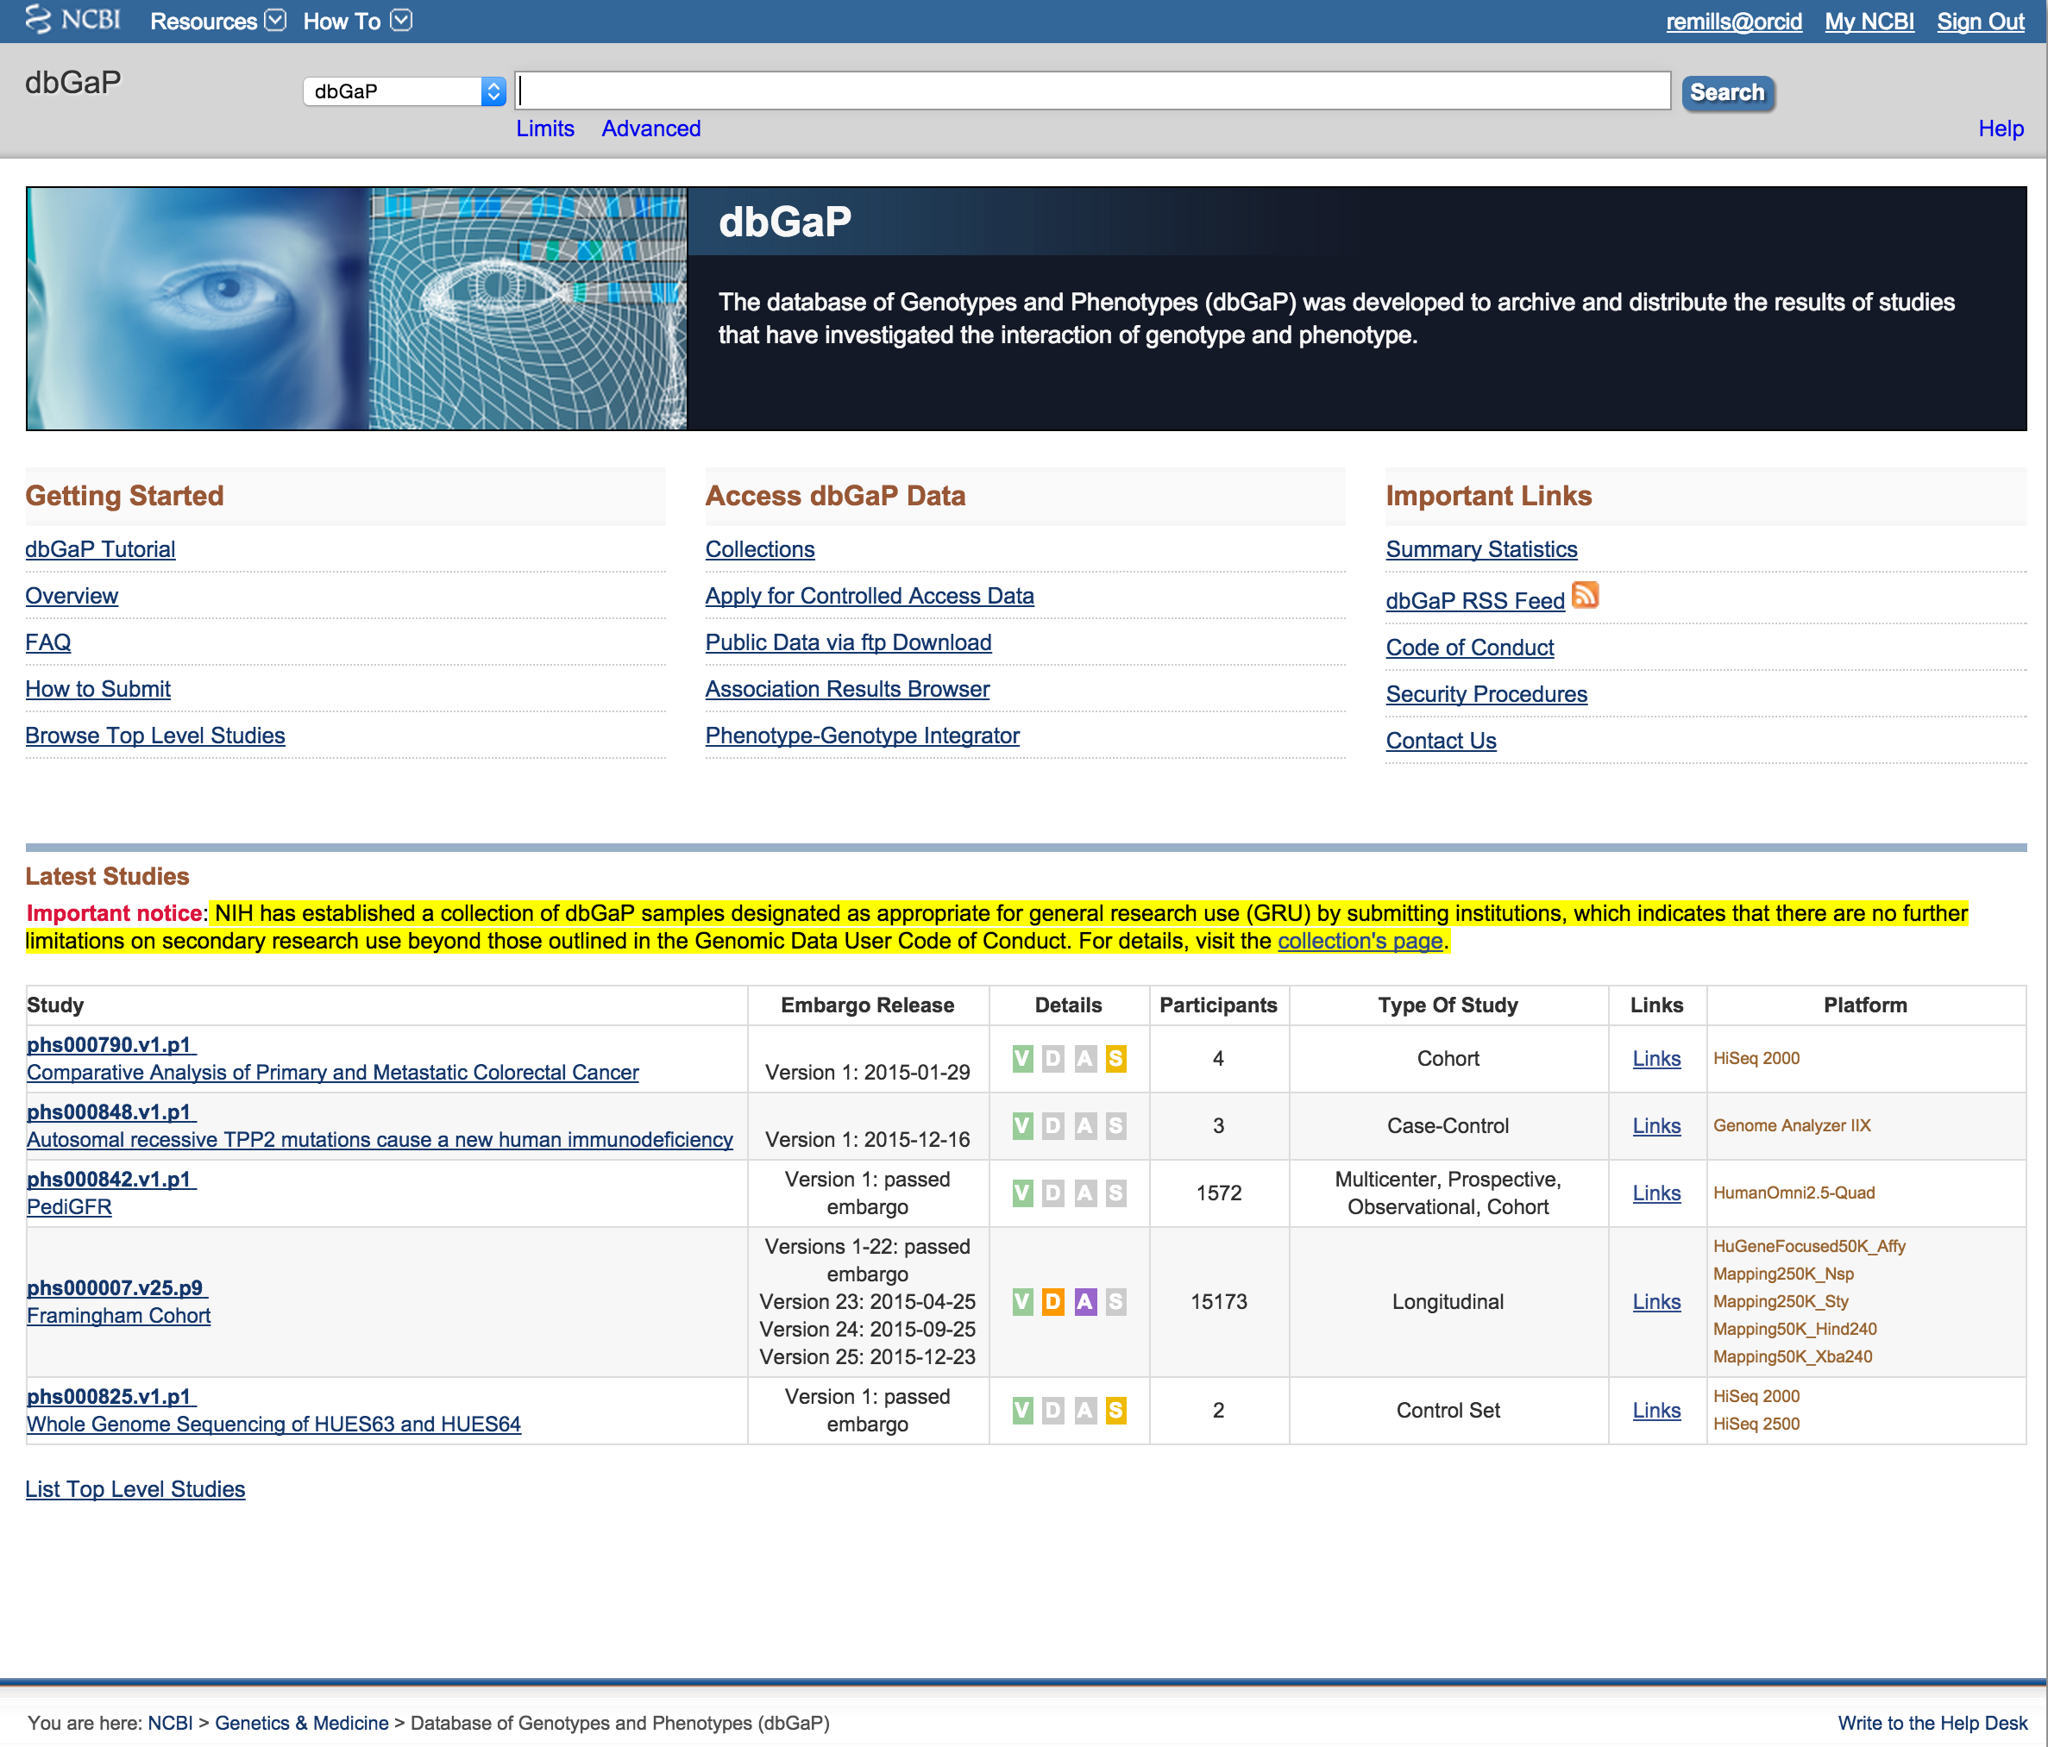
Protected Data - dbGaP
NCBI Database of Genotypes and Phenotypes (dbGaP):
http://www.ncbi.nlm.nih.gov/sra

Slide 73
Galaxy
Galaxy is a useful web-based application for the manipulation of NGS and non-NGS data sets
https://main.g2.bx.psu.edu/
It contains many of the same utilities discussed today, and provides a more standardized approach to analyzing NGS
However, it requires the uploading of data to their server, which typically precludes its application to protected data sets (e.g. human samples)
You are also limited to only those tools which have been incorporated into their system

Slide 74
Galaxy Website

Slide 75
Additional Slides for Reference

Slide 76
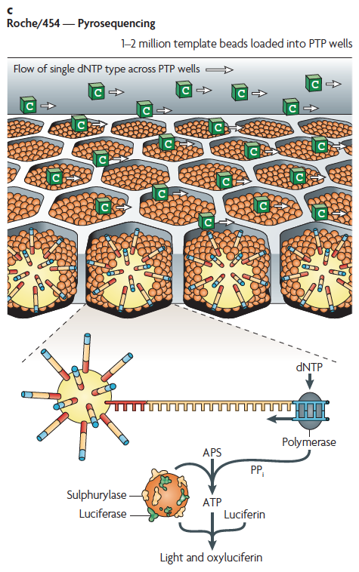
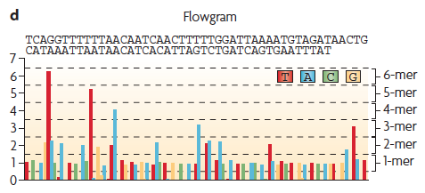
Roche 454 - Pyrosequencing
Metzker, ML (2010), Nat. Rev. Genet, 11, pp. 31-46

Slide 77
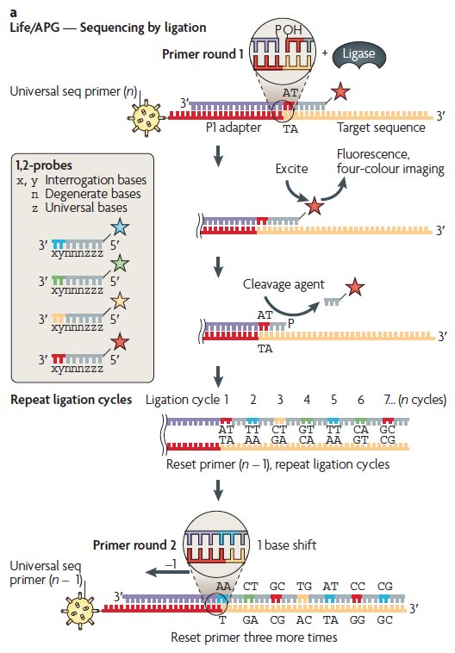
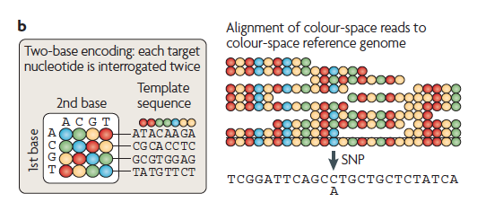
Life Technologies SOLiD – Sequence by Ligation
Metzker, ML (2010), Nat. Rev. Genet, 11, pp. 31-46

Slide 78
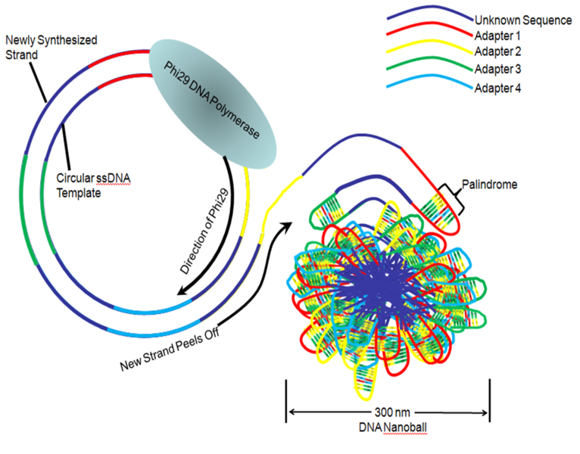
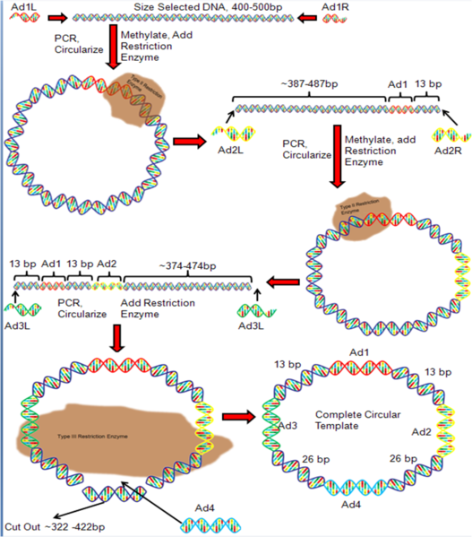
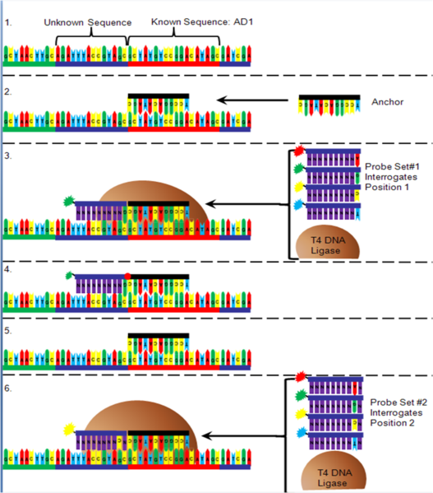
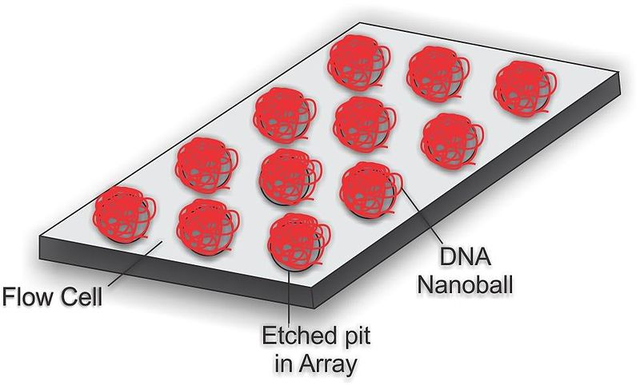
Complete Genomics – Nanoball Sequencing
Has proofreading ability!
Niedringhaus, TP et al (2011), Analytical Chem., 83, pp. 4327-4341
Wikipedia, “DNA Nanoball Sequencing”, September 26, 2012

Slide 79
“Benchtop” Sequencers
Lower cost, lower throughput alternative for smaller scale projects
Currently three significant platforms
Roche 454 GS Junior
Life Technology Ion Torrent
Personal Genome Machine (PGM)
Proton
Illumina MiSeq
Loman, NJ (2012), Nat. Biotech., 5, pp. 434-439

Slide 80
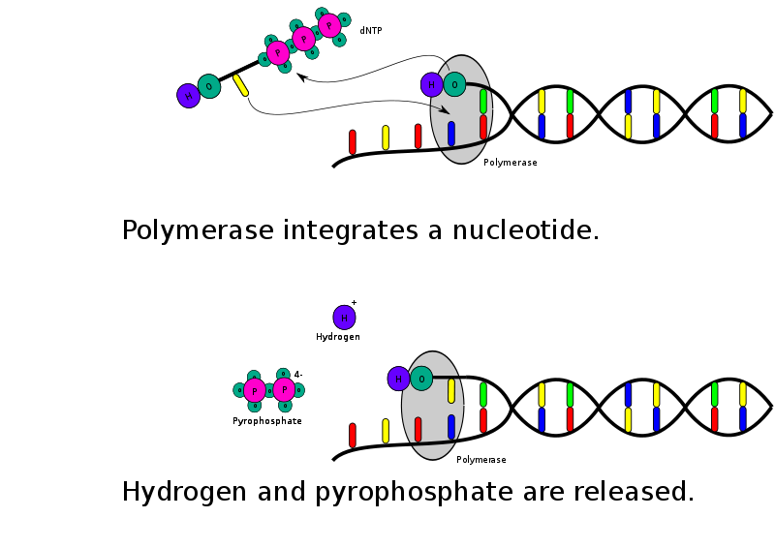
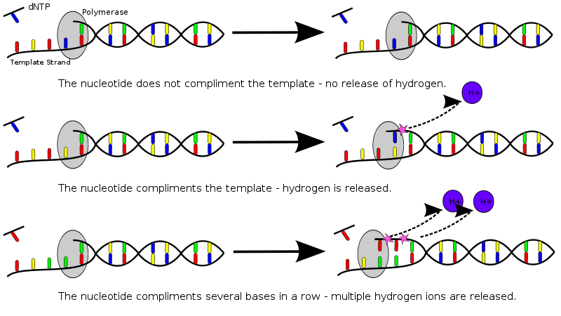
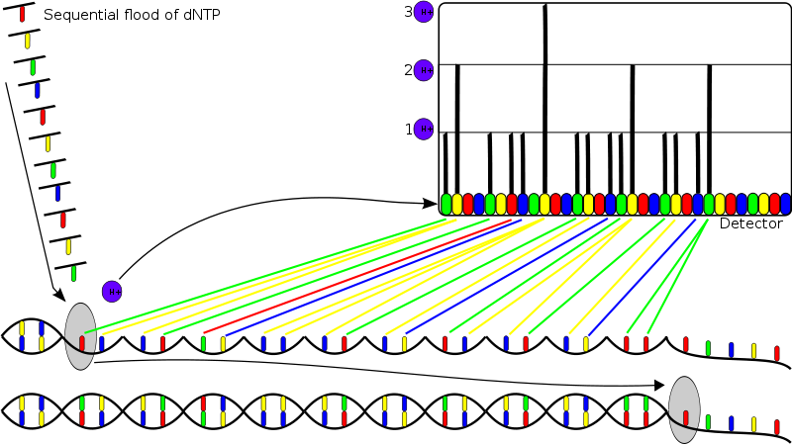
PGM - Ion Semiconductor Sequencing
Wikipedia, “Ion Semiconductor Sequencing”, September 26, 2012

